Slide 1

Physics-constrained Deep Learning for Modeling and Control of Buildings
Invited talk: TU Graz, 1st of March 2021
Jan Drgona
Collaborators: Elliott Skomski, Soumya Vasisht,
Aaron Tuor, Vikas Chandan, Draguna Vrabie

Slide 2
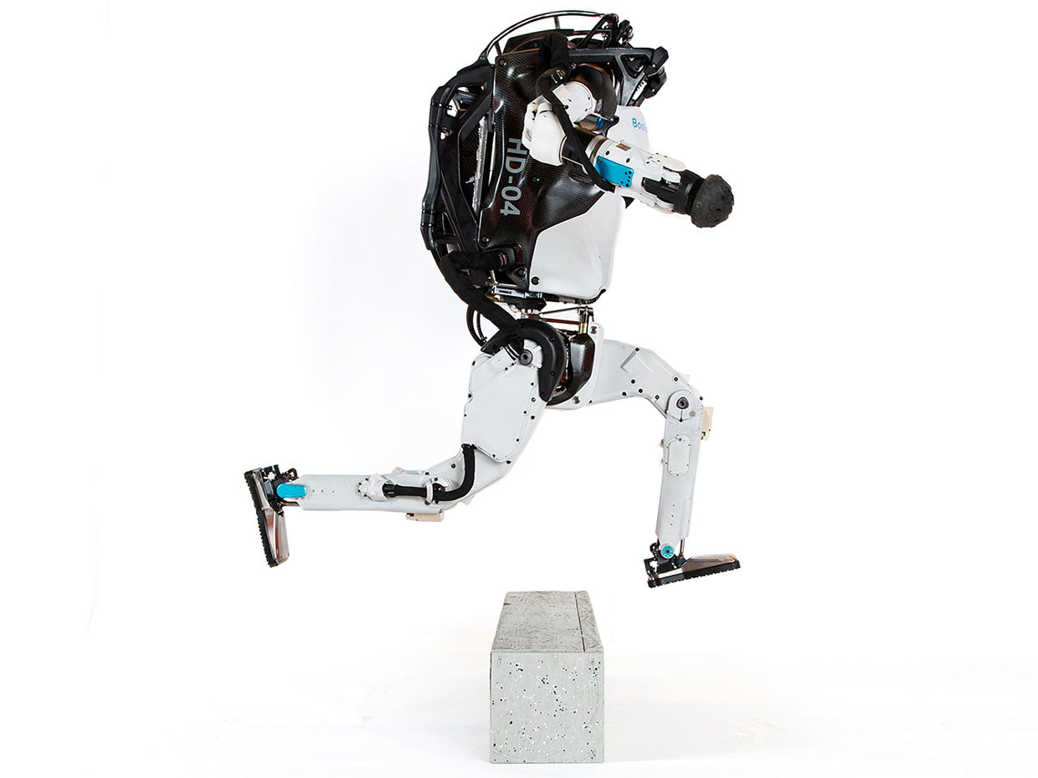
Model Predictive Control
95% of the process control applications are PID loops using trial and error rule-based optimization. The rest is model predictive control (MPC).
PID
Reactive
Simple
Field-level
Suboptimal
Unconstrained
Linear
SISO
MPC
Predictive
Complex
Supervisory-level
Optimal
Constrained
Nonlinear
MIMO
Assumption:
Reliable and accurate system dynamics model
Notes:
Domain awareness, trusted autonomy
PID controller-
A PID controller continuously calculates an error value
the difference between a desired setpoint (SP) a process variable (PV) and
Correction based on proportion of error, integration of accumulated error, and derivative of the error
MPC first developed in the chemical industry to address some of the shortcomings of a PID controller.
Designed to handle MIMO systems
Can handle constraints
Preview capability
MPC uses a model to predict future outcomes of a process.
Online optimization problem at each process interval. Performs first action in the rollout.
requiring large memory and fast processor to operate in real time.
Training and calibration of models- lots of expert time
Optimization: translation to a solver language- lots of expert time
Computational limitations of control hardware depending on the system

Slide 3
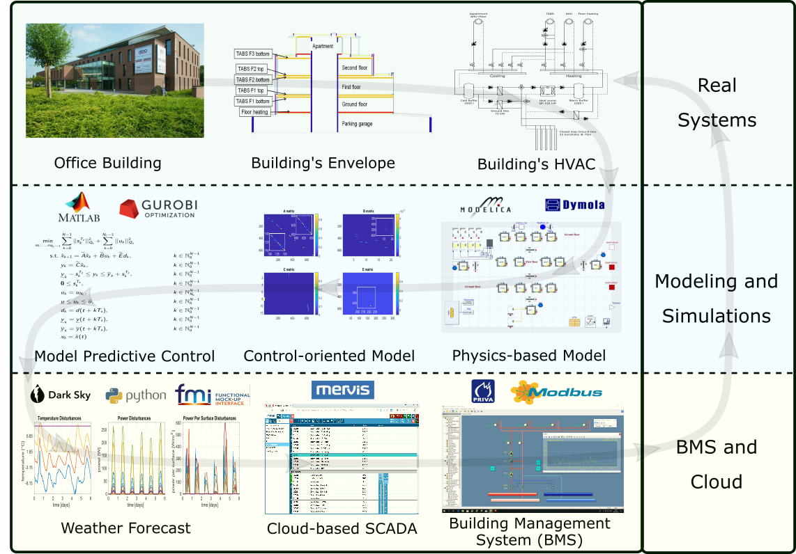
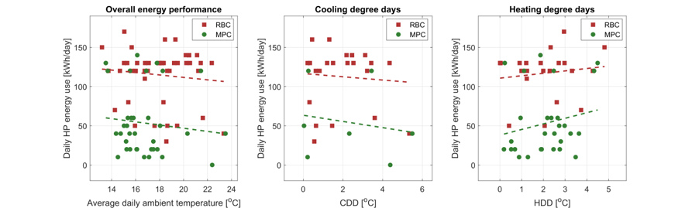
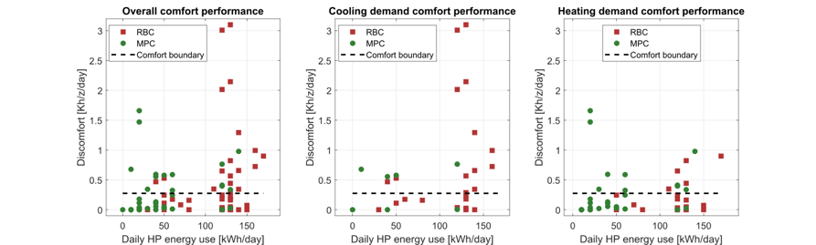

Implementation of MPC in Office Building in Belgium
The field test energy use performance of MPC (green) and RBC (red) during the transient season. Each dot represents one day.
The field test thermal comfort performance of MPC (green) and RBC (red) during the transient season. Each dot represents one day.
Highlights: Heat pump energy savings up to 53%.
Thermal comfort improvement up to 37%.
[1] Drgona J., et al., Cloud-based implementation of white-box model predictive control for a GEOTABS office building: a field test demonstration. Submitted to Journal of Process Control, 2019.
Notes:
To better understand the complexity of the task, lets walk through a complete workflow as implemented for a practical use case to control an office building in Belgium.
This office building is equipped with thermally activated building structures with a geothermal heat pump (GEOTABS). These kinds of buildings are known to be very challenging to control due to the large thermal mass and associated time delays. For optimal operation of this type of systems, predictive control is an absolute must.
First one develops a high-fidelity physics-based model based on the available engineering documentation and measurement data.
Then the control-relevant equations are extracted and used to construct an optimization-based predictive controller.
The optimized controls are computed every 15min based on new weather forecast and new measurement from the building, then the controls are communicated to the building management system for execution.
The whole procedure takes approximately a minute to execute in real time.
After using the MPC in the office building for a couple of months the team measured more than 50% energy savings on the heat pump and improved thermal comfort by approximately 37%. The rigid and delayed behavior of the rule-based controller is replaced by dynamic and anticipatory behavior of MPC, which keeps the zone temperatures closer within comfort bounds and delivers cooling only when it is needed.

Slide 4
MPC Challenges Limit its Broad Adoption
Modeling
Physics-based modeling is expensive and time-consuming
Purely data-driven models lack operational safety guarantees, and do not generalize well
Optimization: translation to a solver language
Multiple customized methods for dealing with constraints (soft, hard)
Multi-objective, convexification, regularization, convergence issues
Computational limitations of control hardware
Online optimization computational requirements
Cloud deployment vs embedded optimization
Acceptance by operators
Installation: data mapping, sensor discovery, tuning
Interpretability, interaction, trust
Performance Measurement & Verification
Drgona J., J. Arroyo, I.C. Figueroa, D. Blum, K. Arendt, D. Kim, and E.P. Olle, J. Oravec, M.Wetter, D.L.Vrabie, L. Helsen. 2020. "All You Need to Know About Model Predictive Control for Buildings." Annual Reviews in Control, September 29, 2020
Notes:
There are four main challenges that must be overcome to make MPC cost-effective
The Training and calibration of models – must be automated
The translation of the optimization problems to a solver language – must be automated
To address the computational limitations of embedded hardware - must reduce computing need without trading performance
Acceptance by building operators – complex decisions must be translated to interpretable decision rules

Slide 5
Approach: Integrate Deep Learning with MPC and Physics
Automate learning of the system dynamics and model-based control policy
Streamline the installation process, facilitate explainability
Endow with lifelong learning and offer performance guarantees during the learning process

Slide 6
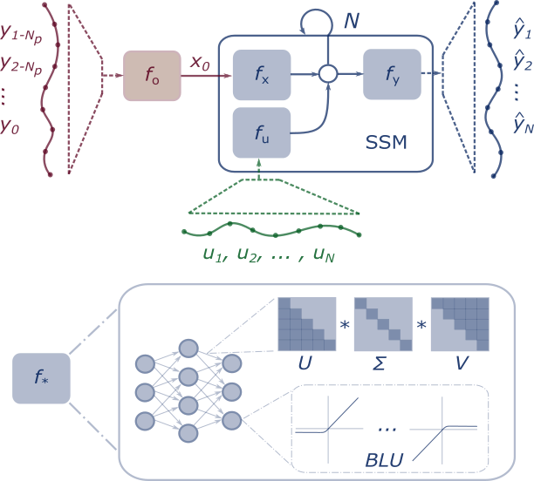
Method: Differentiable Predictive Control (DPC)
Stage I: System Identification
Stage II: Policy Optimization
Fixed SSM Parameters
System ID
Loss
Reference
Tracking
Loss
Dataset of perturbed system measurements
Synthetic random dataset of references and system states
Notes:
Integrate Deep Learning with Optimization-Based Control
Machine learning models that respect physical laws
Incorporate domain knowledge in their architectures
Incorporate domain knowledge with auxiliary loss functions
Use cases
Optimal control
Predictive maintenance
Surrogates for inverse problems
Forecasting for high level planning
Configurable optimization
Sequential
Joint
Alternating
Online updates
Scalable inference
Fast sampling rates
Limited computational resources
High dimensional state space
Long prediction horizons

Slide 7
Domain Aware Nonlinear System Identification: Constrained Neural State Space Models
Machine learning models that respect physical laws and constraints
Incorporate domain knowledge in their architectures
Incorporate domain knowledge with auxiliary loss functions
Block-structured neural state-space model
Neural state estimator
Learnable activation functions
Structured linear maps
Constraints enforcing penalties
Aaron R Tuor, Ján Drgona, Draguna L Vrabie Constrained Neural Ordinary Differential Equations with Stability Guarantees, Code release: https://github.com/pnnl/neural_ODE_ICLR2020

Slide 8
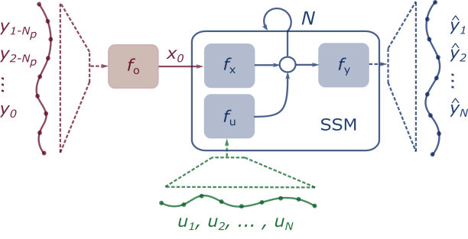
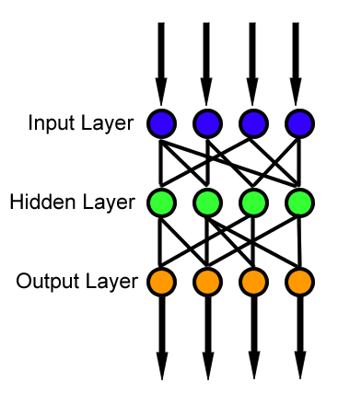
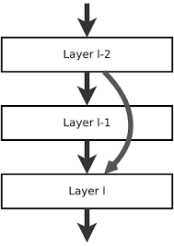
Neural Network Block Structure and Components
Multi-layer perceptron
Function approximator
Composed linear maps and nonlinear activation functions
Model complicated functions
adding depth (more layers)
and/or width (more nodes)
Residual Neural Network
Adds shortcut connections
Easier to optimize
Mitigates vanishing gradient
Recurrent Neural Network
Adds recurrences from previous inputs
Sequential modeling
Can model time delay
f

Slide 9
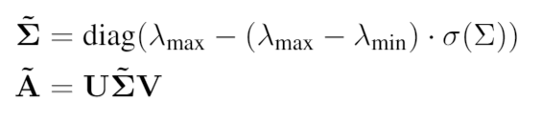
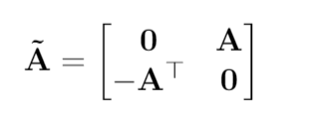
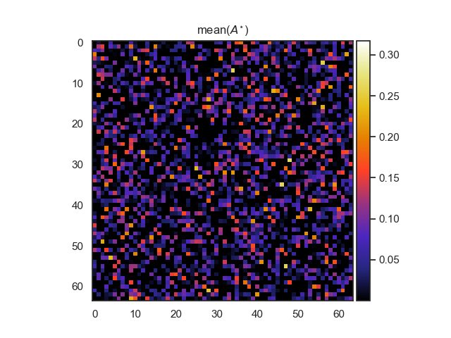
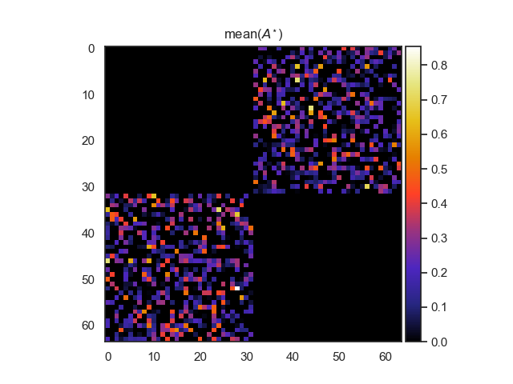
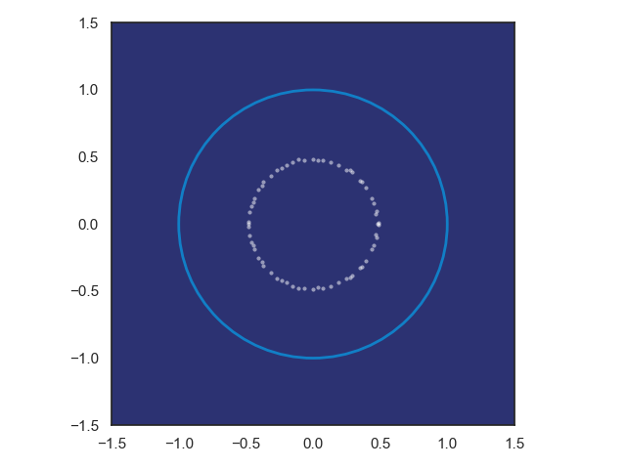
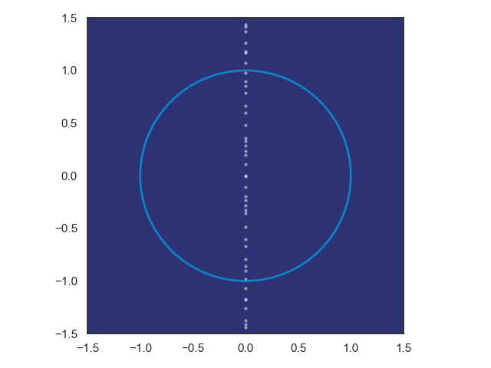
Structured Linear Maps with Eigenvalue Constraints
SVD factorization
Hamiltonian weight
Jiong Zhang, et al., Stabilizing Gradients for Deep Neural Networks via Efficient SVD Parameterization, 2018. Eldad Haber and Lars Ruthotto, Stable Architectures for Deep Neural Networks 2017 Jan Drgona, Aaron Tuor, Soumya Vasisht, Elliott Skomski, Draguna Vrabie, Spectral Analysis and Stability of Deep Neural Dynamics, arXiv:2011.13492 Code: https://github.com/pnnl/slim

Slide 10
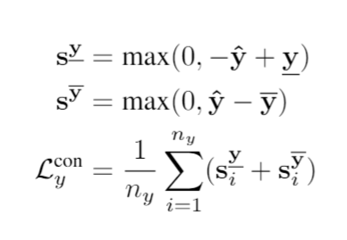
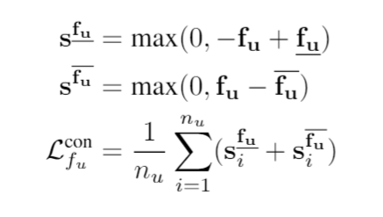
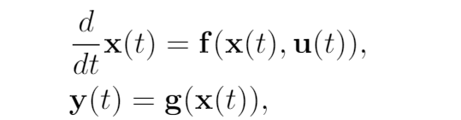
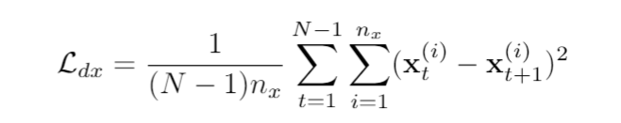
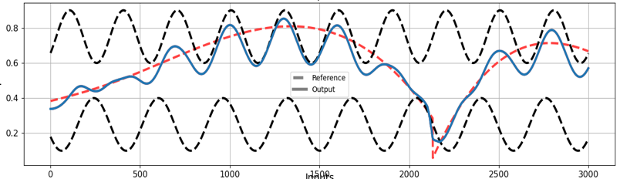
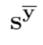
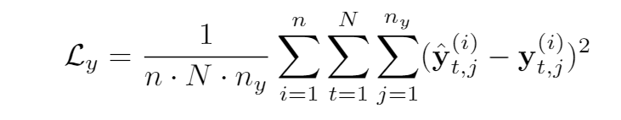
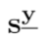
Training Loss Includes System Knowledge
Bound influence of input and bound output to physical range
Partially observable non-autonomous system
Data needs:
Predicted State Smoothing
Optimize N-step prediction horizon MSE

Slide 11
Modeling Thermal Dynamics
Ján Drgona, Aaron R. Tuor, Vikas Chandan, Draguna L. Vrabie, Physics-constrained Deep Recurrent Neural Models of Building Thermal Dynamics, NeurIPS Climate Change AI Workshop, 2020
Implementation in PyTorch https://github.com/pnnl/neuromancer/tree/NeurIPS2020

Slide 12
Real World Data: Office Building

Slide 13
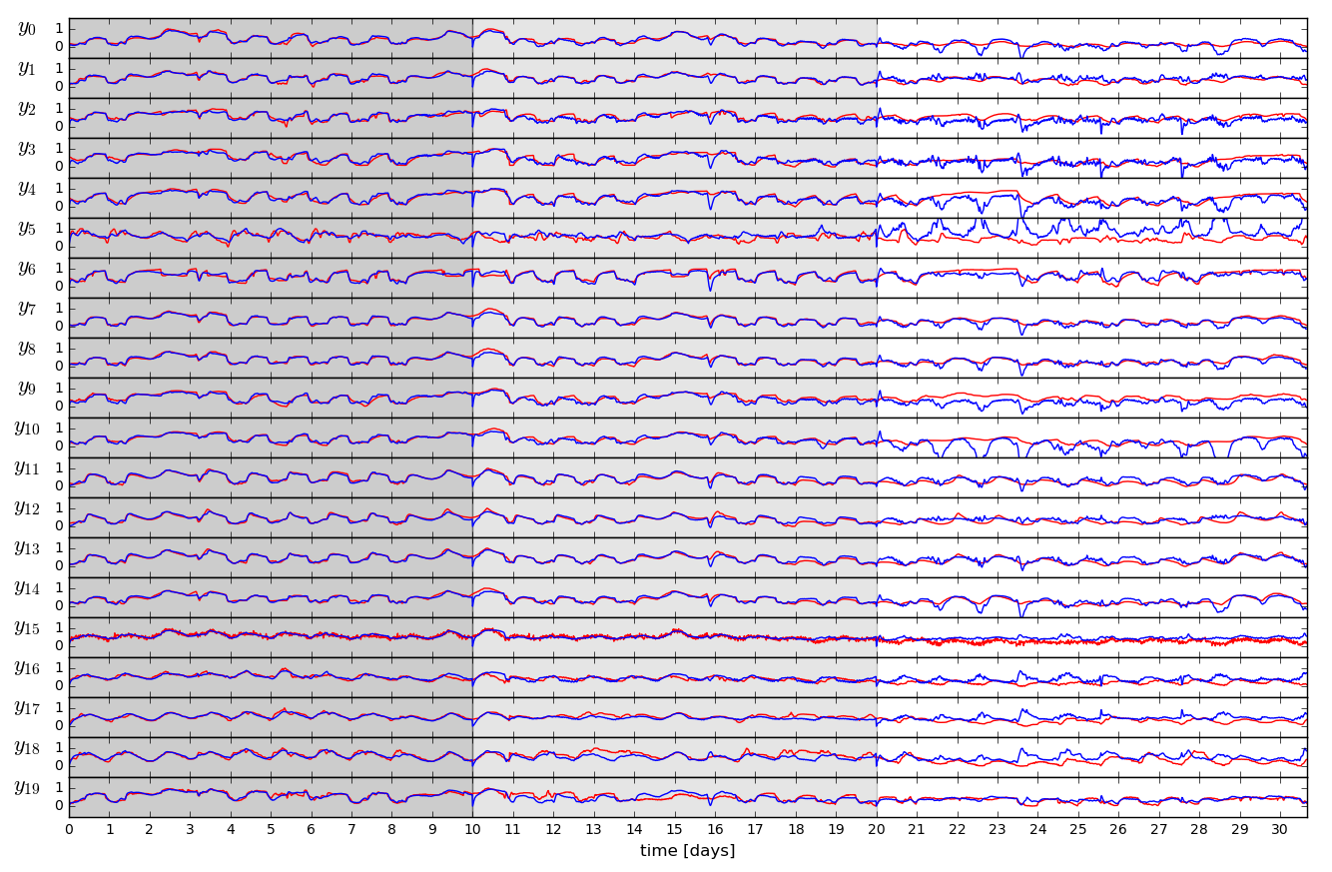
Open-loop Trajectories of Linear Dynamics Model

Slide 14
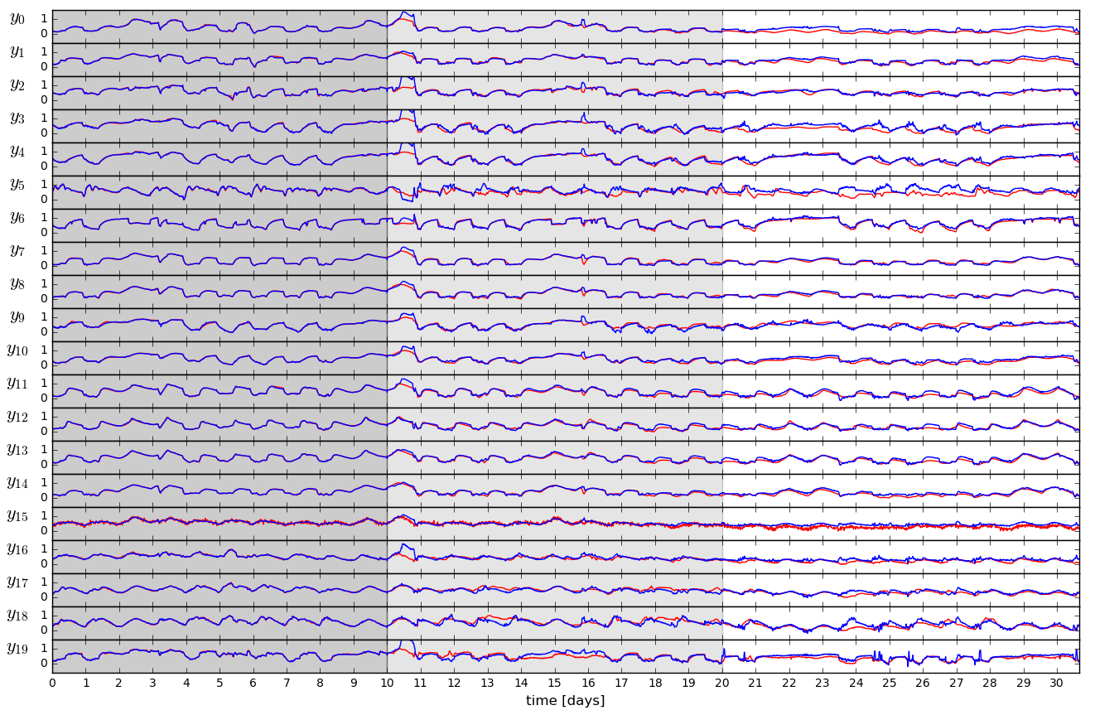
Open-loop Trajectories of Neural Dynamics Model

Slide 15
Deep Learning of Model-based Control Policies
Objectives
Cut the development and deployment cost of model-based control
Learn safe and robust control policies with adaptive updates
Embedded hardware implementation
Approaches
Approximate MPC
Imitation learning of supervisory MPC
Differentiable Predictive Control
Supervised policy learning in closed loop guided by learned model

Slide 16
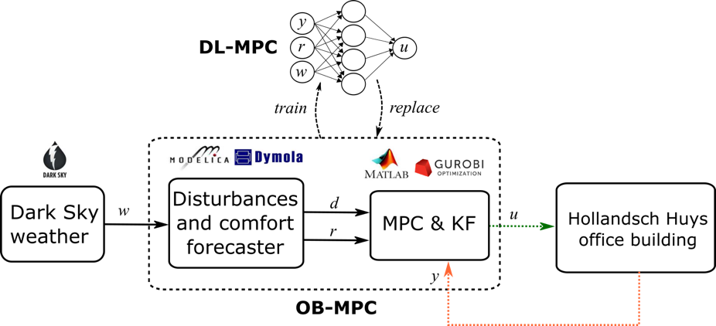
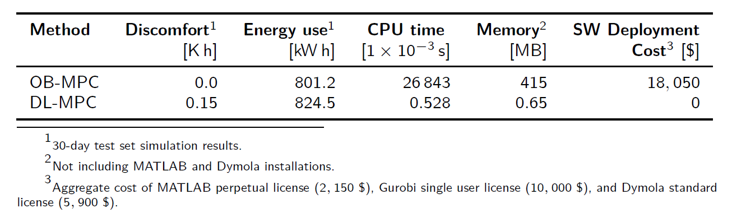
Deep Learning-based Approximations of MPC
Pros
Can accurately approximate MPC
Low CPU and memory demands
Cons
Loosing performance guarantees
Still relies on original MPC
Drgona J., et al., “Approximate model predictive building control via machine learning,” Applied Energy, 2018
Drgona J., Helsen L., Vrabie D., “Stripping off the implementation complexity of physics-based model predictive control for buildings via deep learning.” NeurIPS Climate Change AI workshop, 2019.
Drgona J., Helsen L., Vrabie D.,"Cutting the Deployment Costs of Physics-Based MPC in Buildings by Simulation-Based Imitation Learning.”, proceedings of Dynamic Systems and Control Conference 2020, - Best paper award

Slide 17
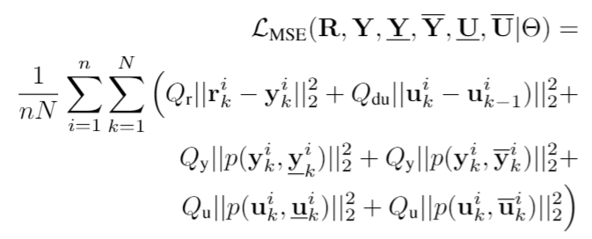
Differentiable Predictive Control (DPC)
Generic method for constrained model-based control
Can be trained end-to-end from time series dataset
Nonlinear constrained optimal control
Neural system dynamics model
Predictive reference tracking
Constraints satisfaction
Balancing conflicting objectives
Economic objectives
Scalability beyond the limitations of explicit MPC
Explicit neural network-based control policy
Linear scalability w.r.t. memory footprint, number of policy parameters, and required construction time
Potential for wide adoption in large-scale control systems with limited computational resources and fast sampling rates
Jan Drgona, et al., Differentiable Predictive Control: An MPC Alternative for Unknown Nonlinear Systems using Constrained Deep Learning https://arxiv.org/abs/2011.03699
Jan Drgona, Aaron Tuor, Draguna Vrabie, Constrained Physics-Informed Deep Learning for Stable System Identification and Control of Unknown Linear Systems https://arxiv.org/abs/2004.11184

Slide 18
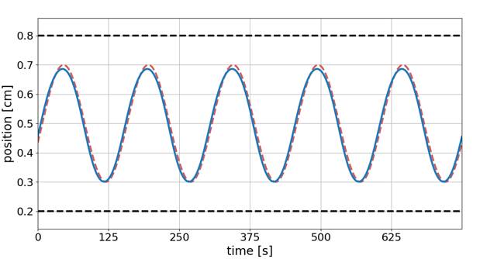
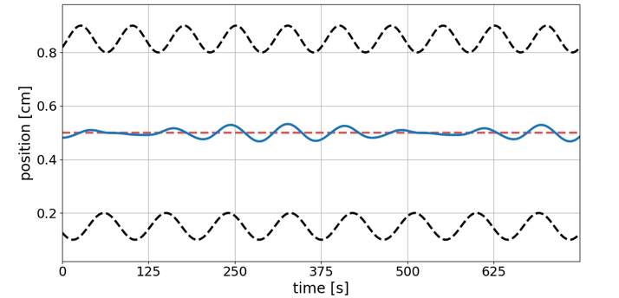
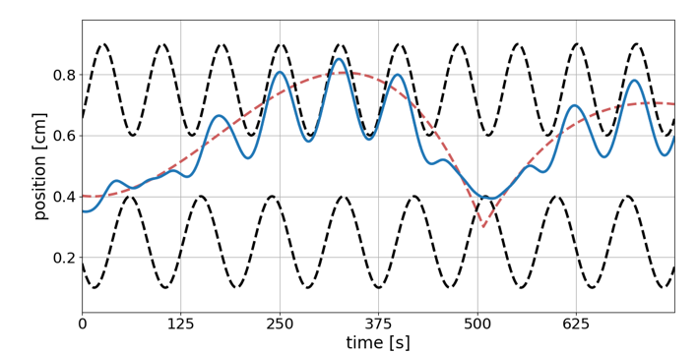
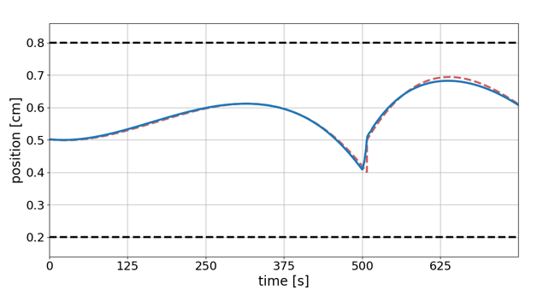
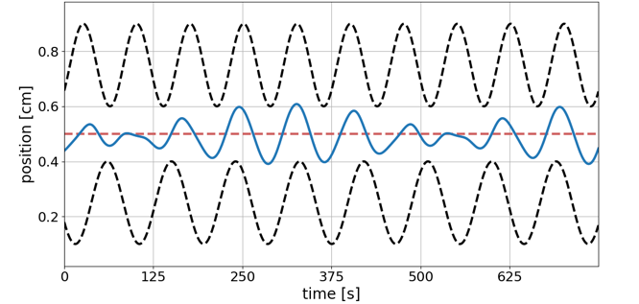
Capability: Computationally efficient performance optimization with operational safety constraints
--- Reference trajectory
--- Constraints
__ Controlled trajectory
Reference tracking performance
Response to constraint tightening
Balancing conflicting objectives
Notes:
Computationally efficient performance optimization with operational safety constraints

Slide 19
Model Predictive Control vs Differentiable Predictive Control
DPC = Formulation of MPC problem as a constrained deep learning model
Drgona J., Tuor A., Vrabie D., Constrained Physics-Informed Deep Learning for Stable System Identification and Control of Linear Systems, Code release: https://github.com/pnnl/deps_arXiv2020

Slide 20
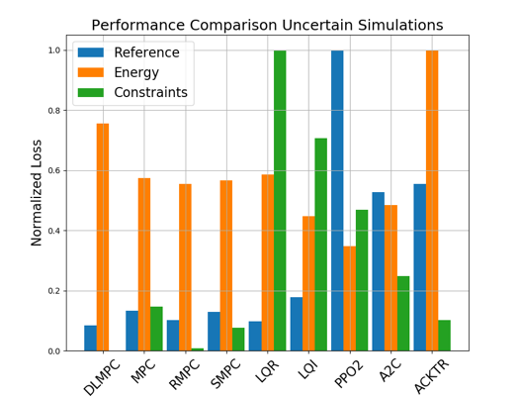
Comparison of DPC with MPC, LQR, and RL
Closed loop trajectories. Top: controlled state (orange), internal model predictions (green), given reference (dashed blue), and constraints (dashed black). Middle: control action (blue) and bounds (dashed black). Bottom: disturbances
Control performance comparison in simulations with parametric and additive uncertainties. Control Strategies: MPC, Robust MPC , Stochastic MPC, LQR, LQI, A2C: Asynchronous, deterministic variant of Advantage Actor Critic, ACKTR: Actor Critic using Kronecker-Factored Trust Region, PPO2: Proximal Policy Optimization
Drgona J., Tuor A., Vrabie D., Constrained Physics-Informed Deep Learning for Stable System Identification and Control of Linear Systems, Code release: https://github.com/pnnl/deps_arXiv2020

Slide 21
Embedded Implementation of DPC
Flexy-Air system sketch with Raspberry-Pi controller
Performance comparison: reference (red dashed), position controlled with PI controller (green), explicit model predictive control (purple), constrained differentiable predictive control (blue) and constraints (black-dashed). Bottom figures show the fan speed controls
Jan Drgona, Karol Kis, Aaron Tuor, Draguna Vrabie, Martin Klauco, Differentiable Predictive Control: An MPC Alternative for Unknown Nonlinear Systems using Constrained Deep Learning; arXiv:2011.03699

Slide 22


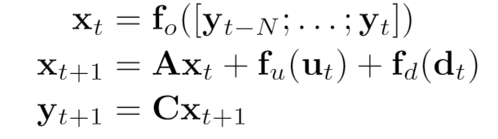
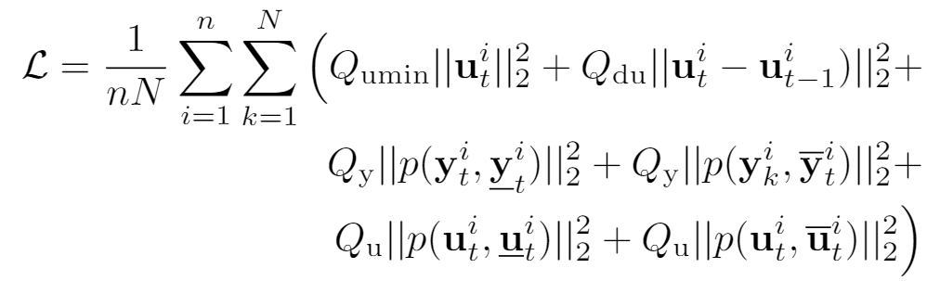
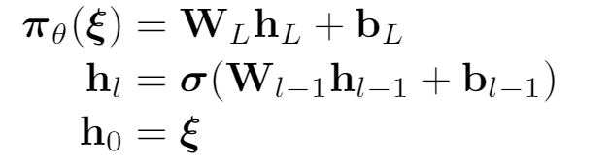
DPC for Building Control
Economic MPC loss function
model
policy
Jan Drgona, Aaron Tuor, Elliott Skomski, Soumya Vasisht, Draguna Vrabie, Deep Learning Explicit Differentiable Predictive Control Laws for Buildings, under review IFAC NMPC 2021

Slide 23
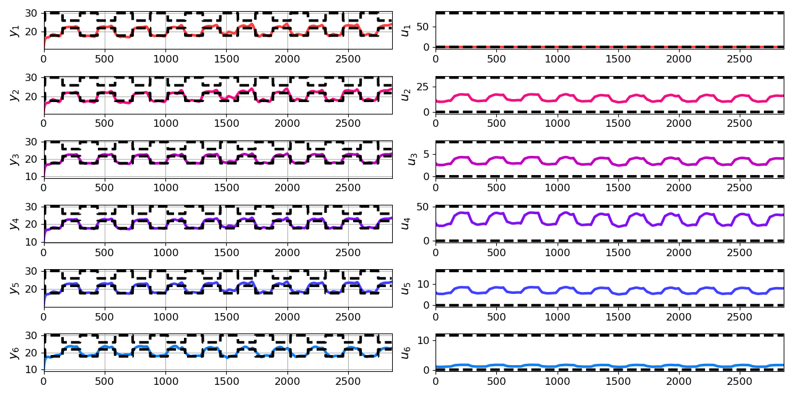
Closed-loop Performance of DPC on Learned Model without Plant-Model Mismatch
Jan Drgona, Aaron Tuor, Elliott Skomski, Soumya Vasisht, Draguna Vrabie, Deep Learning Explicit Differentiable Predictive Control Laws for Buildings, under review IFAC NMPC 2021

Slide 24
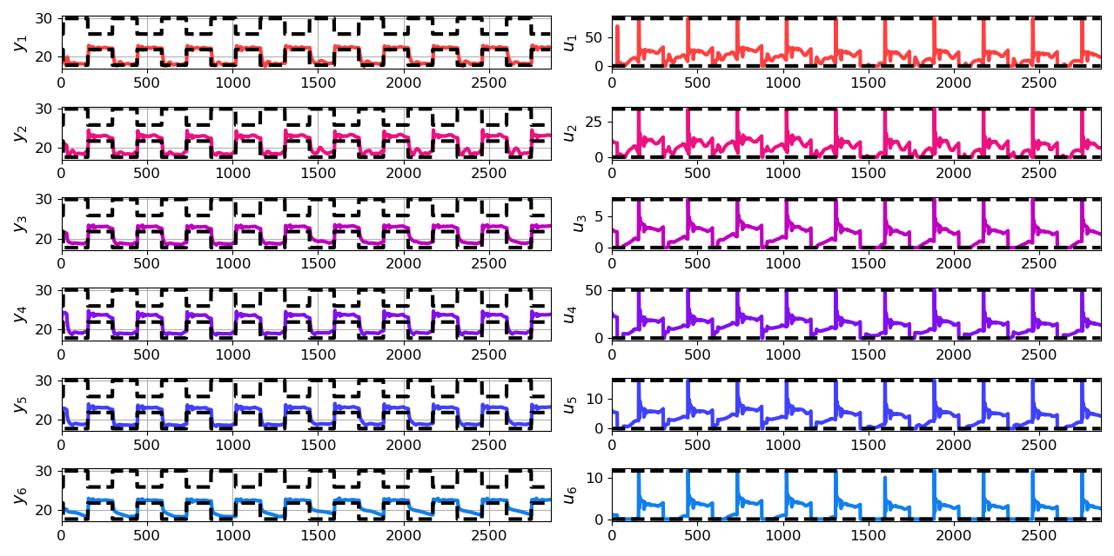
Closed-loop Performance of DPC on Emulator Model with Plant-Model Mismatch
Jan Drgona, Aaron Tuor, Elliott Skomski, Soumya Vasisht, Draguna Vrabie, Deep Learning Explicit Differentiable Predictive Control Laws for Buildings, under review IFAC NMPC 2021

Slide 25
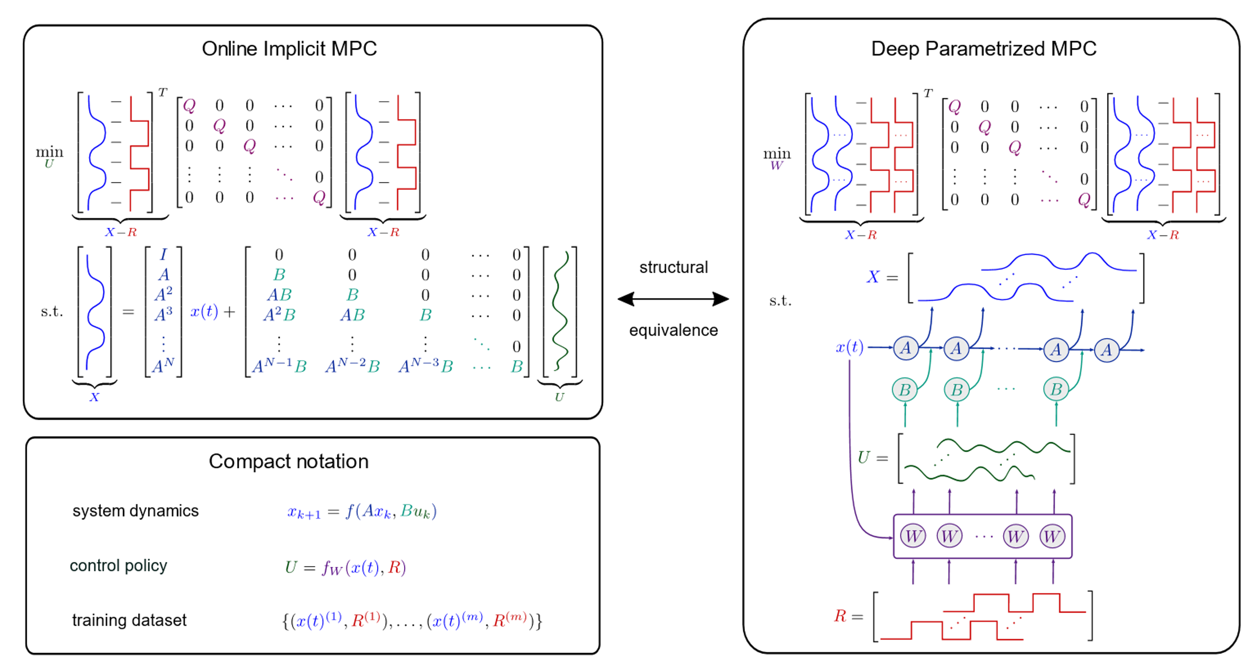
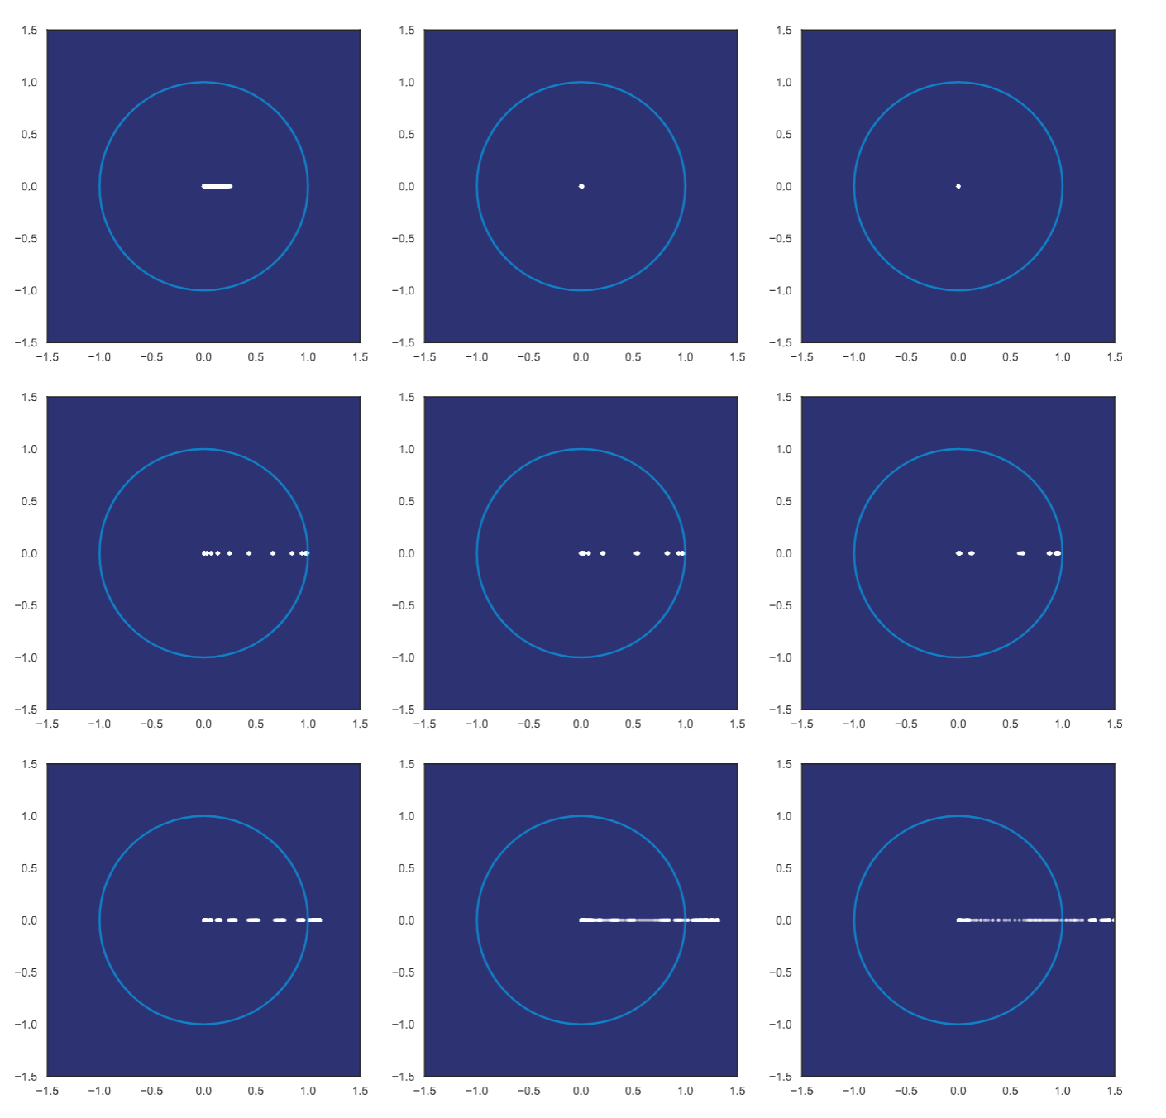
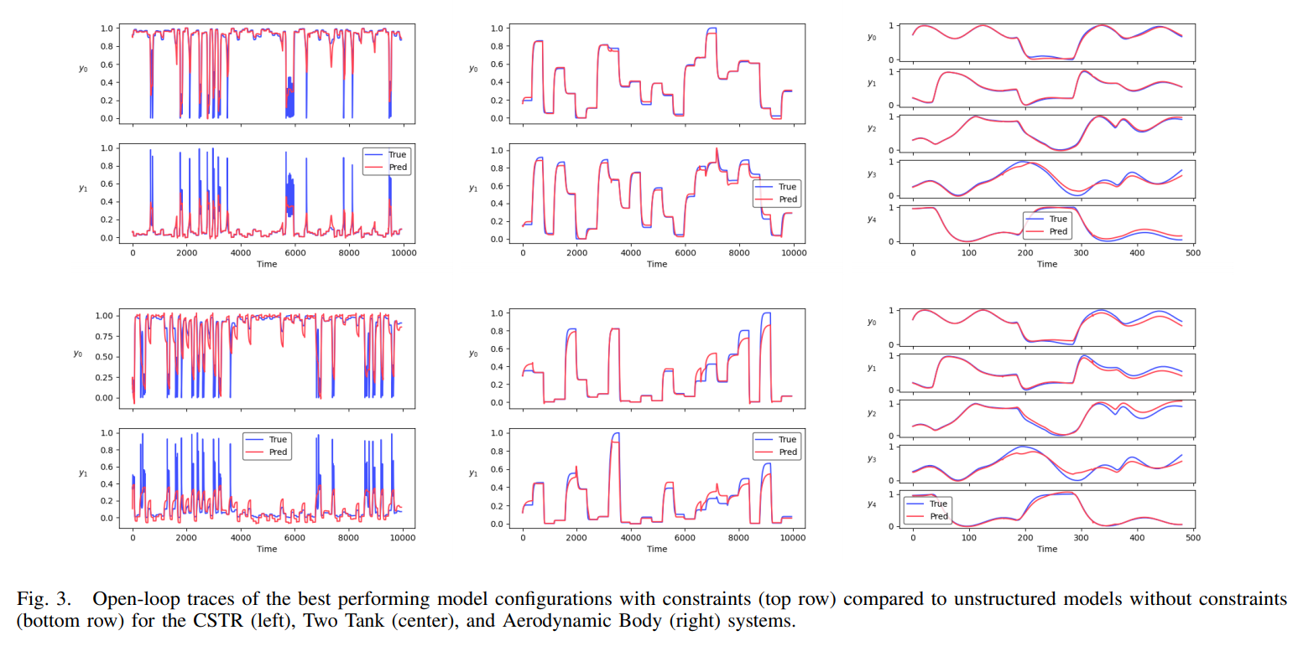
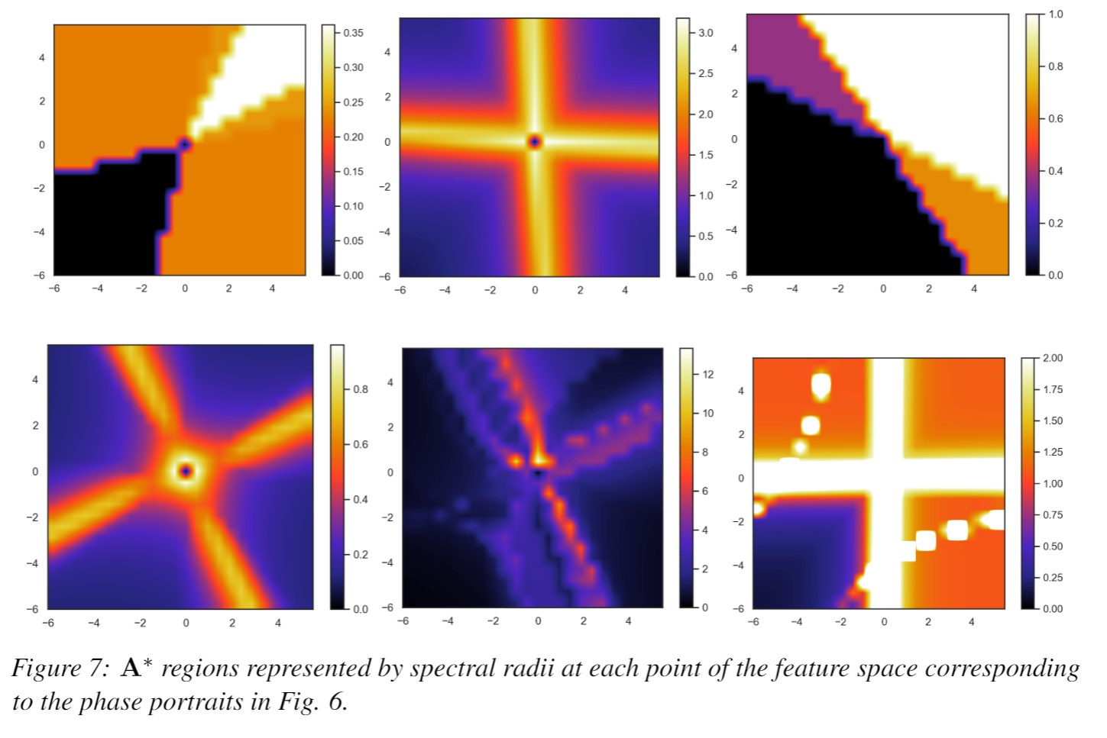
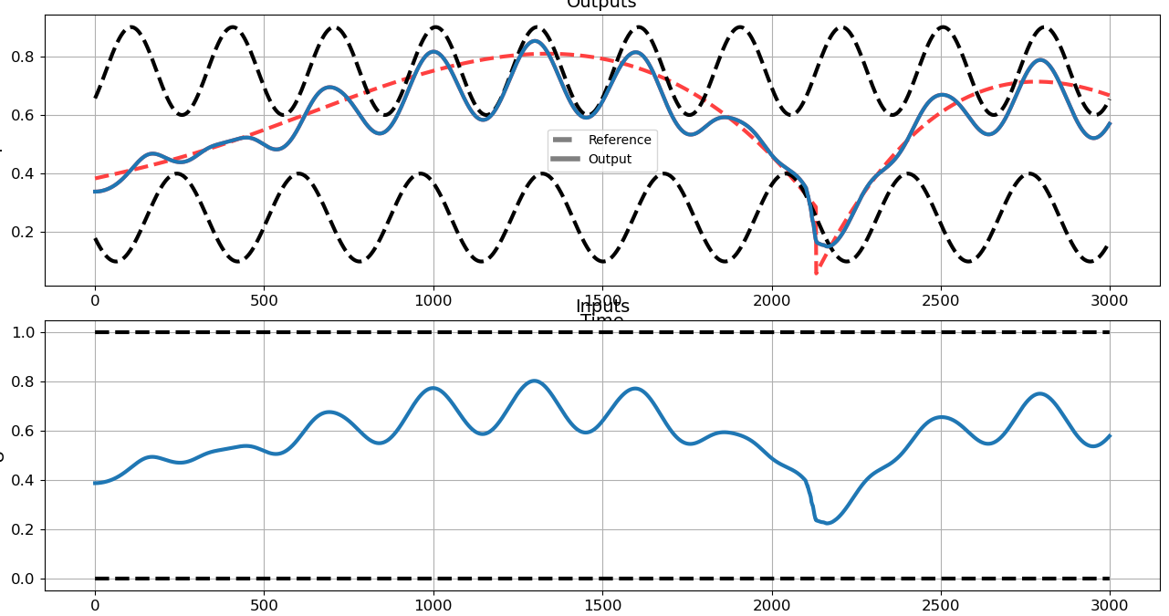
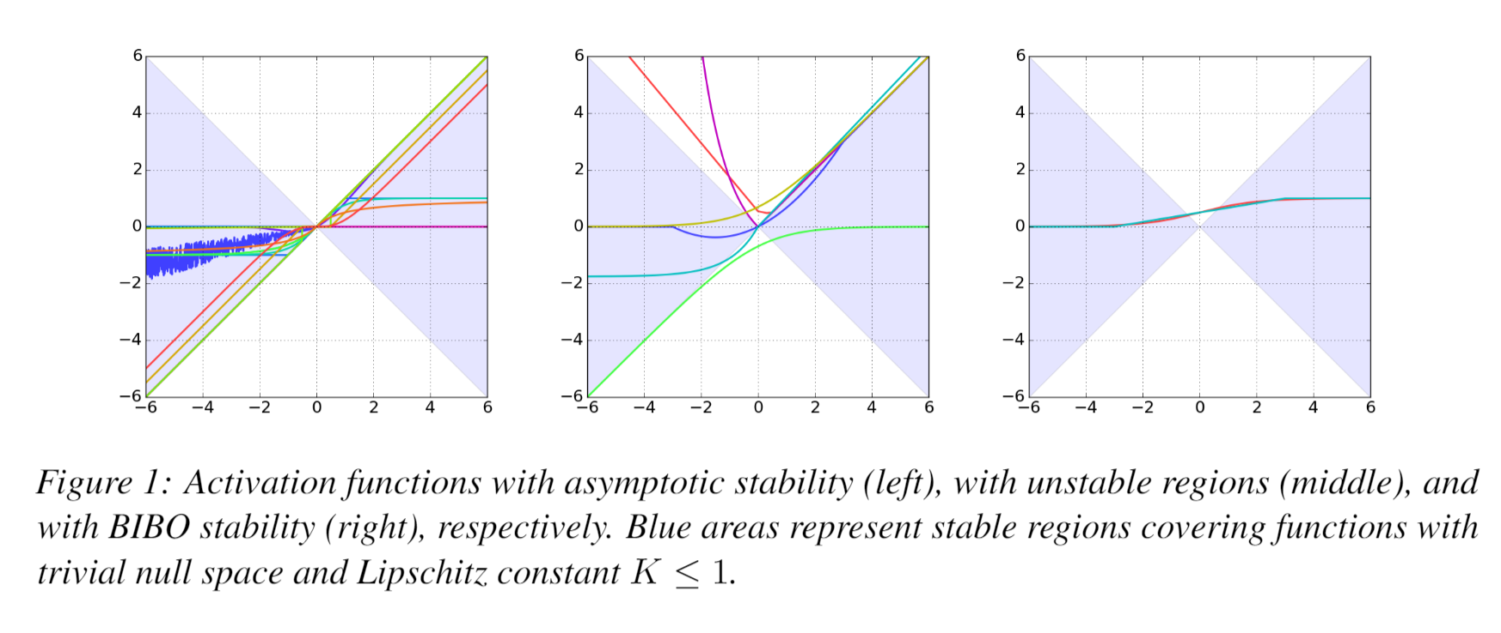
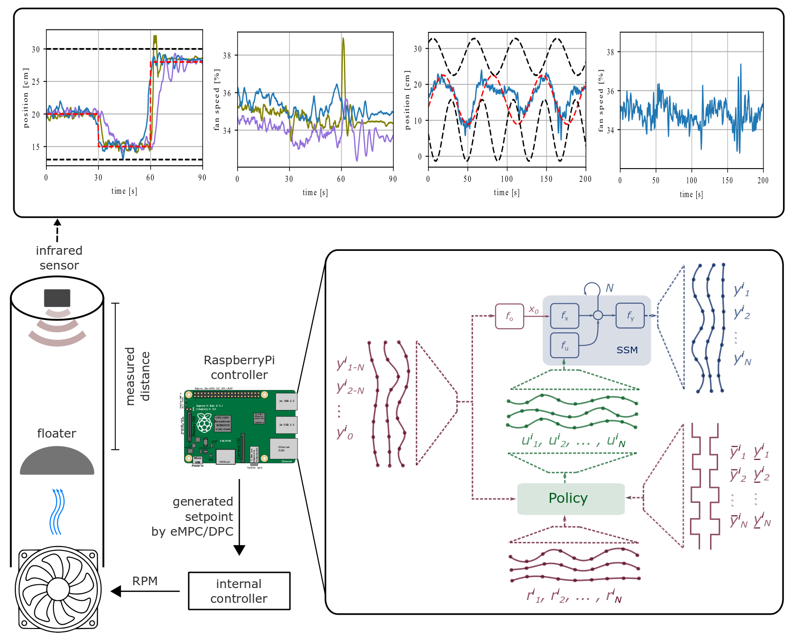
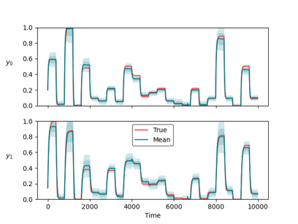
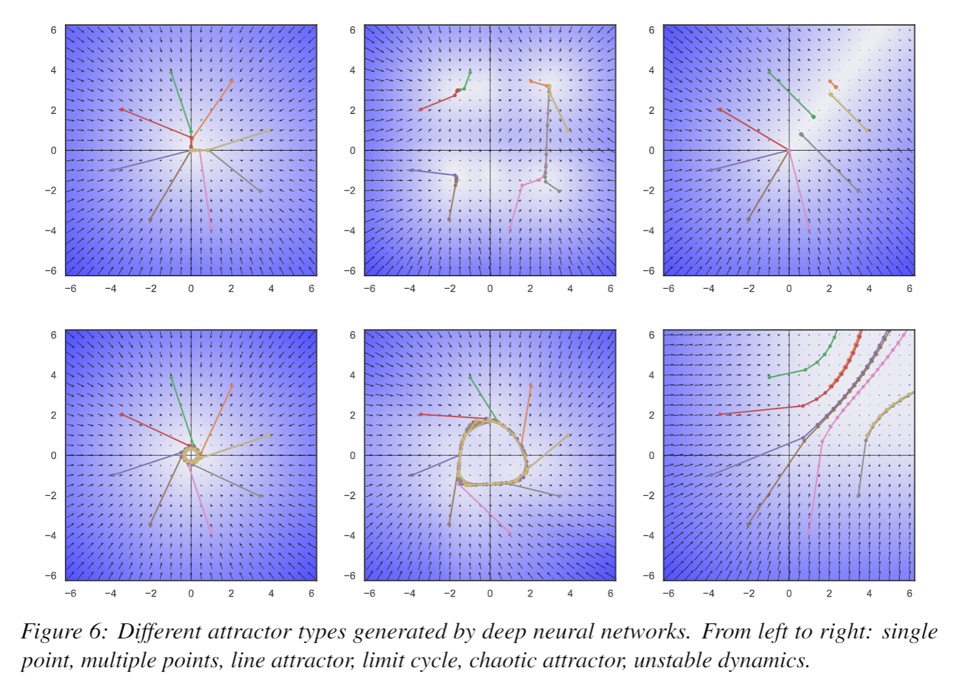
Conclusion
Differentiable Predictive Control
Neural state space model for system ID
Physics-informed priors (neural gray-box)
Incorporating operational constraints
Theoretical connection with MPC
Explicit neural control policies
Embedded implementation with low-cost HW
Learning from small datasets
Ongoing work
Uncertainty Quantification
User-friendly software package
Pytorch-based will be released soon: https://github.com/pnnl/neuromancer
Comprehensive suite of physics-based priors and constraints
Structured linear maps in Pytorch: https://pnnl.github.io/slim/
Theoretical guarantees: convergence, stability, constraints satisfaction
Long-Term Vision
Causal discovery, dynamical coupling
Solving large-scale non-convex constrained optimization problems
Real world applications in energy, manufacturing, cyber

